Slide 1
Restaurant management system
CAPSTONE PROJECT
Presented By:
NITHISHWAR S -2021311026
B.TECH PETROLEUM ENGINEERING AND TECHNOLOGY
AC TECH - ANNA UNIVERSITY

Slide 2
OUTLINE
Problem Statement
Proposed System/Solution
System Development Approach
Algorithm & Deployment
Result
Conclusion
Future Scope
References

Slide 3
Problem Statement
The manual billing process leads to delays for customers and inefficiencies within the organization, indicating a need for enhancement. Transitioning to a computer-based billing system could improve resource allocation. This system streamlines data entry for client, employee, and payment information, streamlining record management and fulfilling organizational data needs. Notable drawbacks of the current approach include:
- Restricted data modification capabilities
- Reliance on manual operator supervision
- Excessive paper consumption
- Difficulty in accessing information promptly
- Challenges in maintaining systematic records
- Paper wastage

Slide 4
Proposed Solution
The Restaurant Management System (RMS) is a digital tool that streamlines the billing process for offering a quick and user-friendly interface. It reduces customer wait times by automating the billing process, generating bills quickly and accurately. RMS can manage large volumes of data, allowing for efficient storage and easy retrieval of billing history, reservation information, and staff details.
This desktop-based software is designed for simplicity, requiring little to no paperwork. It automates the calcurestaurants, lation of customer bills, including discounts, which helps reduce manual errors and speeds up the process. All information is securely stored in a database, eliminating the need for physical record-keeping and minimizing the risk of data loss. By using RMS, restaurants can improve their operational efficiency and ensure a smoother customer experience, as the system helps manage key tasks with ease and accuracy.

Slide 5
System Approach
Developing a restaurant management system in Python involves a meticulous approach, delineated into the following steps:
1.Requirements Analysis: Begin by conducting an in-depth analysis of the system's requirements, encompassing aspects such as menu customization, order processing workflows, reservation handling nuances, inventory management intricacies, and comprehensive reporting functionalities.
2. Modular Architecture: Craft a modular architecture, meticulously organizing the system into finely-tailored modules, each dedicated to handling specific functions with precision. Modules could include Menu Management, Order Processing, Reservation Handling, Inventory Control, and Advanced Reporting.
3. Class Abstraction: Employ class abstraction within each module to encapsulate entities and actions elegantly. Define intricate class hierarchies to represent various components, such as Menu Items, Order Instances, Reservation Details, and Inventory Items, ensuring a granular level of control and flexibility.

Slide 6
System Approach
4. Relationship Mapping: Delve into relationship mapping between classes/modules, orchestrating seamless interactions and dependencies. Detail how orders are intricately linked to menu items, how inventory levels dynamically adjust based on orders, and how reservations seamlessly integrate into the overall operational flow.
5. Functional Implementation: Implement robust methods and functions within each class/module, meticulously orchestrating the execution of diverse tasks. This could involve intricate algorithms for menu updates, streamlined workflows for order processing, efficient algorithms for inventory management, and seamless integrations for reservation handling.
6. User Interface Design: Craft a user interface that mirrors the sophistication of the system's underlying architecture. Whether opting for a sleek command-line interface, an intuitive graphical interface leveraging libraries like Tkinter or PyQt, or a seamless web-based interface powered by Flask or Django, prioritize user experience and accessibility.
7. Thorough Testing and Iterative Refinement: Conscientiously conduct thorough testing to validate the system's functionality and reliability. Embrace an iterative refinement process, incorporating user feedback and testing insights to continually enhance the system's robustness and performanc

Slide 7
Algorithm & Deployment
1. Efficient Menu Organization:
Develop a structured menu item class to capture key details like name, price, and description.
Implement a dedicated system for managing menu items, ensuring smooth addition, removal, and display processes.
2. Streamlined Order Processing:
Establish a robust order framework, incorporating essential elements such as order ID, selected items, and total price.
Introduce seamless functionalities for adding items, accurate price calculation, and efficient order processing.
3. Seamless Reservation Handling:
Define a comprehensive reservation structure, vital information like reservation ID, customer name, date, and table allocation.
Create an intuitive reservation management system, allowing for hassle-free reservation creation, availability checks, and cancellations.

Slide 8
Algorithm & Deployment
4. Effective Inventory Management:
Introduce a well-structured inventory framework, highlighting key attributes such as item name, quantity, and price.
5. Insightful Reporting Capabilities:
Develop robust inventory management tools for effortless stock addition, real-time quantity updates, and proactive low stock alerts. Incorporate advanced reporting functionalities to generate customized reports, including sales and inventory reports, tailored to specific user requirements.
6. User-Friendly Interface Design:
Design an intuitive interface to facilitate seamless user interaction, offering flexible options such as command-line, web-based, or GUI interfaces to accommodate diverse user preferences.
7. Flexible Deployment Solutions:
Explore versatile deployment strategies, including local deployment using PyInstaller, web-based deployment with Flask or Django, mobile app deployment via Kivy or React Native, containerization with Docker, and hybrid deployment for comprehensive operational coverage

Slide 9
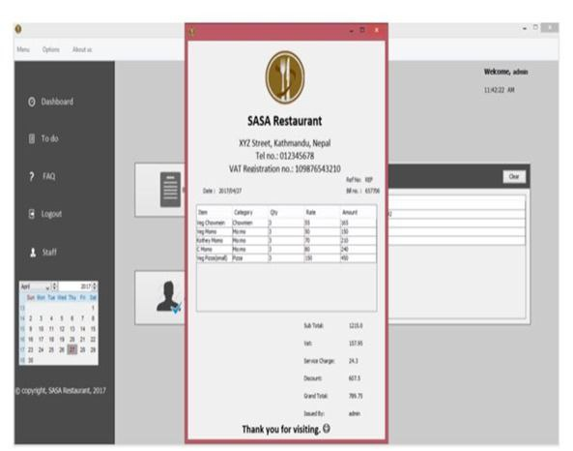
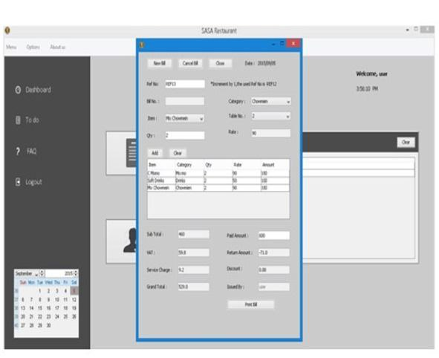
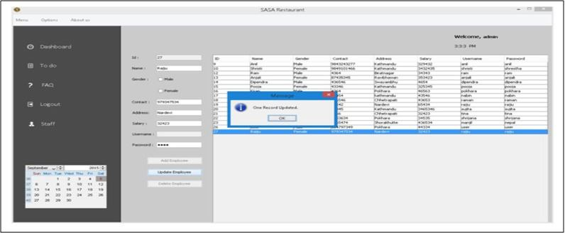
Result
Examining the Restaurant Billing System's performance, it effectively oversees staff information, customer reservations, billing procedures, and additional functionalities. Upon evaluation, the system showcases strong capabilities in managing staff data, including adding, editing, updating, and deleting records. Furthermore, it streamlines reservation processes, supports cancellations, and generates bills for customers. The system's outputs are visually presented in the accompanying figure for reference.

Slide 10
Conclusion
"The documentation offers a detailed explanation of the structure and code behind the Restaurant Management system. Building this program was quite an undertaking, requiring in-depth analysis, thorough research, and specific technical skills. Preparing this report has been a fulfilling experience, with many lessons learned from the demanding tasks involved. Creating a system for a restaurant needed a combination of research and technical expertise, and ensuring seamless operations required significant time and energy.
Despite the difficulties, the system was completed with a solid design and efficient workflow. The billing system presented the most significant challenge. Extracting data from the database for billing required intricate SQL queries and involved handling multiple changes across different databases, which was time-consuming and required careful thought.
Overall, this project provided a great deal of coding experience and demonstrated the importance of good time management and teamwork when developing software systems."

Slide 11
Future scope
The restaurant management software (RMS) is a versatile toolset designed to streamline every facet of restaurant operations. From managing staff and processing orders to handling billing, menus, reservations, and more, it offers a comprehensive suite of features. Looking ahead, the software is ripe for innovation and advancement. Potential upgrades such as advanced inventory control, wireless tableside ordering and payment solutions, real-time alerts, online ordering integration, and mobile management capabilities present opportunities for revenue growth and operational efficiency improvements.

Slide 12
References
Restaurant Billing System: https://www.scribd.com/doc/283903672/Online-Ordering-System-
Project Objective :https://www.scribd.com/document/36253350/04-Project-Billing- System
Scopes and Limitation: https://kungfumas.files.wordpress.com/2017/09/099.pdf
Feasibility study: http://www.slideshare.net/alok104/synopsis-on-billing-system-27487568
UML Diagram : https://www.techopedia.com/definition/3243/unified-modeling-language-uml/
Use Case Diagram: http://whatis.techtarget.com/definition/use-case-diagram
Class Diagram: http://searchmicroservices.techtarget.com/definition/class-diagram
Sequence Diagram : https://creately.com/blog/diagrams/sequence-diagram-tutorial/
ER Diagram: http://searchcrm.techtarget.com/definition/entity-relationship-diagram
Interfaces : https://www.youtube.com/watch?v=9K5sS7j5wWI

Slide 13
THANK YOU

